Slide 1

Transfer Learning: The Hugging Face Platform

Slide 2


Slide 3

A Tour through the Hugging Face Hub
https://huggingface.co/models
https://huggingface.co/datasets

Slide 4
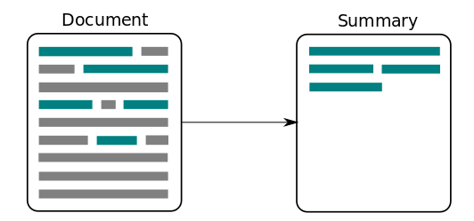
Let’s say you want to build a news summarizer…
“Tesla’s stock plummets as CEO tweets nonsense.”
Notes:
Image Credit: https://medium.com/@jaskiratnandhra/extractive-text-summarization-for-english-hindi-tamil-4cf37e81091c

Slide 5
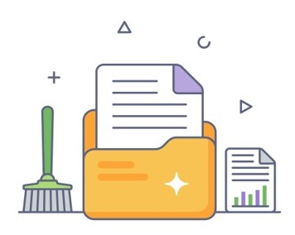
First, you’d need to collect and clean a dataset
Notes:
https://www.vecteezy.com/vector-art/6094871-data-cleaning-in-flat-outline-icon-editable-vector

Slide 6
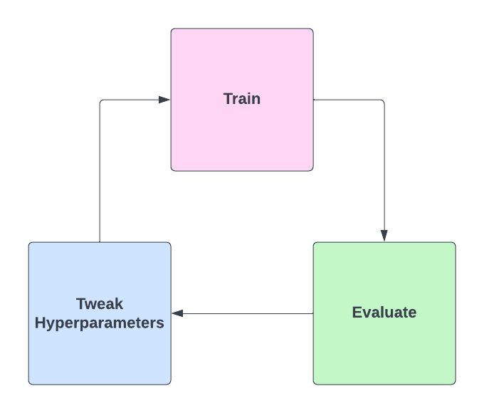
Then, you’d need to pick and train a model…
…which can take a while

Slide 7
Is there an easier way?
Leverage work of the ML ecosystem
Don’t reinvent the wheel
Collaborate-first culture
Open Source
Notes:
Well, this can be much simpler actually.
If you’ve used GitHub before, your approach when doing software related projects was likely to find repositories with tools to solve some of the problems you had. You collaborate with your team by having a shared repository. And once you’re ready, you can open source for the whole ecosystem to use. We can do the same with ML!
Why do we have hundreds of people training a model for the same things again and again? What if we could instead have a central platform through which people could collaborate, explore, and discover models and datasets.
That’s where Hugging Face comes in. The HF Hub is a platform with over 30K models and 3K datasets in which people can easily collaborate in their ML workflows.

Slide 8
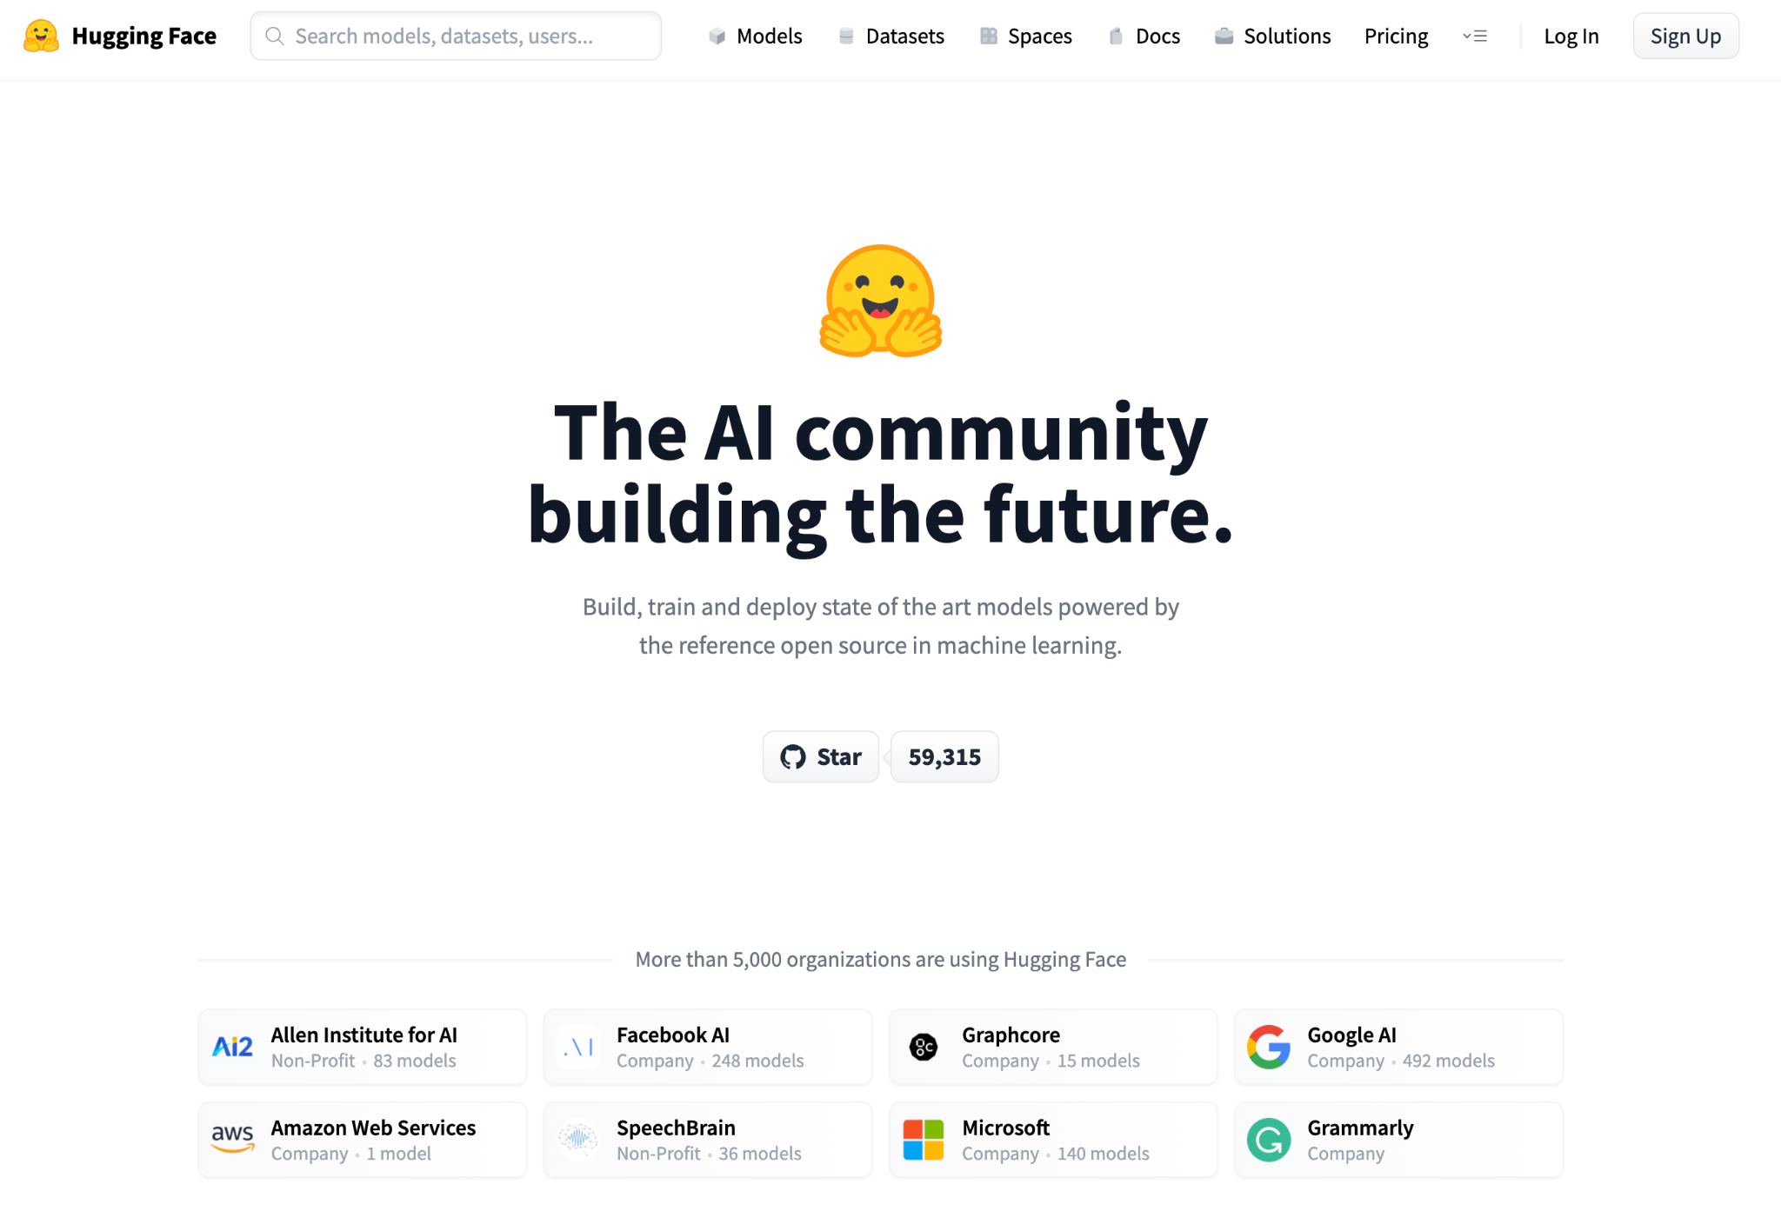

Notes:
So how do we plan on doing that?
First of all, we aim to make Machine Learning accessible:
it should be easy to access, and easy to try things out.
We have several approaches to this
Engineering via our Open Source libraries.
Open science, by sharing all the science that we do, pretrained weights and applications

Slide 9

Solving all kinds of problems
📖
🗣️
👀
NLP
Speech
Vision
Domain X
🧬
📈
🤖
Time Series
RL
Bio/Chem
Notes:
And although our origins come from the NLP domain, nowadays the HUb has expanded to applications across other domains:...
Our main goal is to democratize good Machine Learning
making it accessible to everyone
give the ability to anyone to contribute to the greater goal of solving language

Slide 10
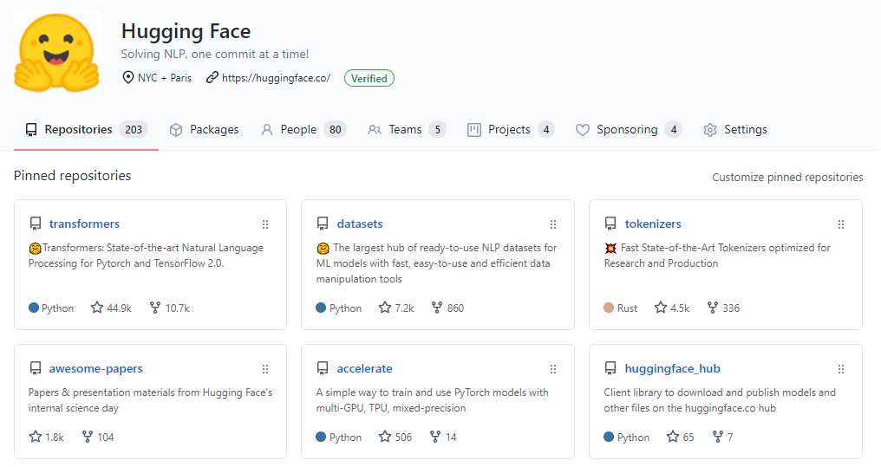
Brief tour through Open Source family
Notes:
Today we’ll take a look exclusively at the Open Source Ecosystem of HuggingFace.
medium of Open Source sharing is through GitHub
you can observe a few of our repositories here.
We will dive in the repositories showcased here in the following slides.
Being on GitHub is important for us as a community-centered endeavour
Across our libraries, we have more than 1000 different Open Source contributors without which the libraries wouldn’t exist.
58K stars in GitHub

Slide 11
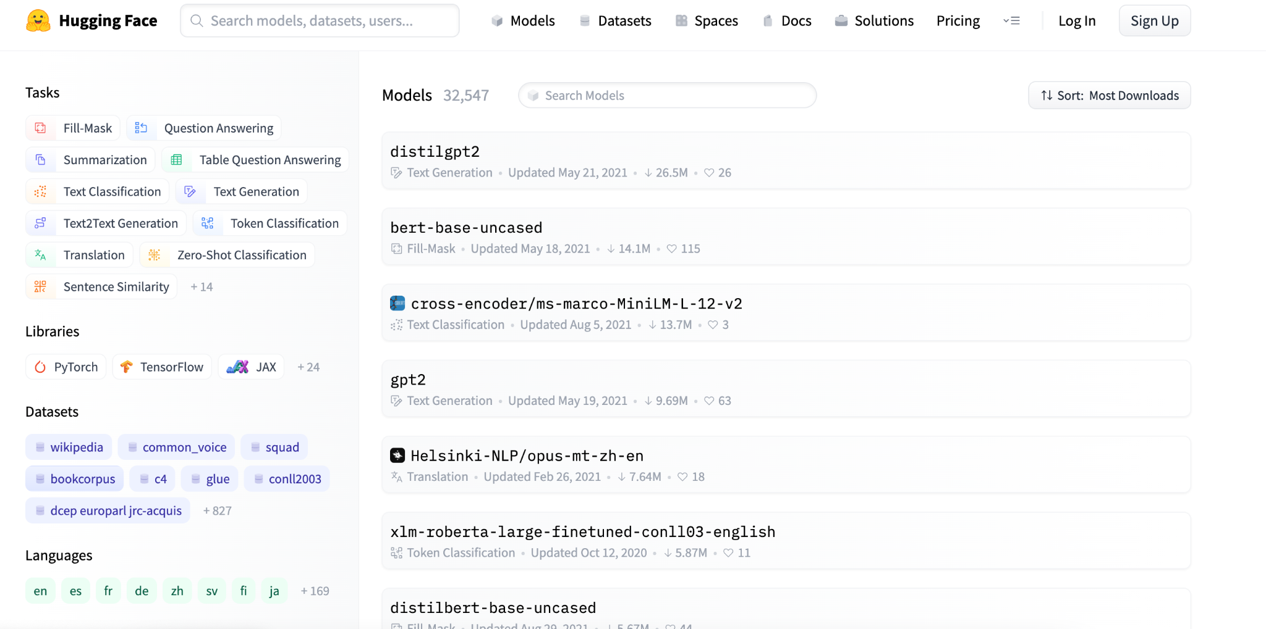
How can I find models?
Notes:
First of all, as a starting point, let us begin with the model hub. The model hub is a central repository for models across different frameworks: transformers, as you all probably know, but also other NLP frameworks like AllenNLP or Flair, vision frameworks like pytorch-image-models, or timm, and other fields like speech, with pyannote, ESPNet, and others.
This screenshot is a bit outdate at 5241 models, and we actually just passed a milestone recently of 30 000 models shared on the model hub. The hub serves as a central sharing point for all models – at shines in multiple aspects:
- It enables reproducibility. By sharing checkpoints, users offer them to be tested by other users, and evaluated
- It saved on training, as pretrained models being shared allows easy fine-tuning on top of models trained on huge amounts of data

Slide 12
The Model Hub
>30,000 public models
>20 tasks
>15 libraries
>180 languages

Slide 13
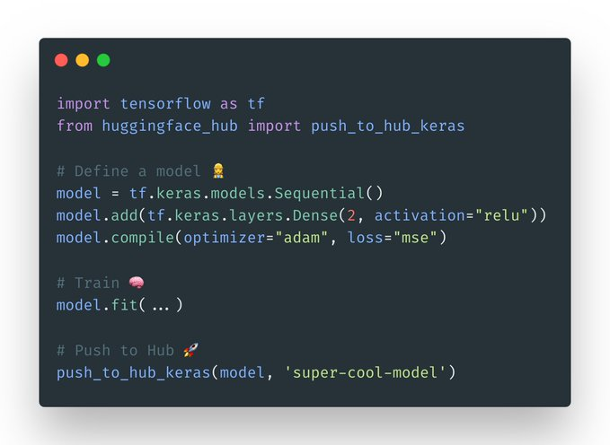
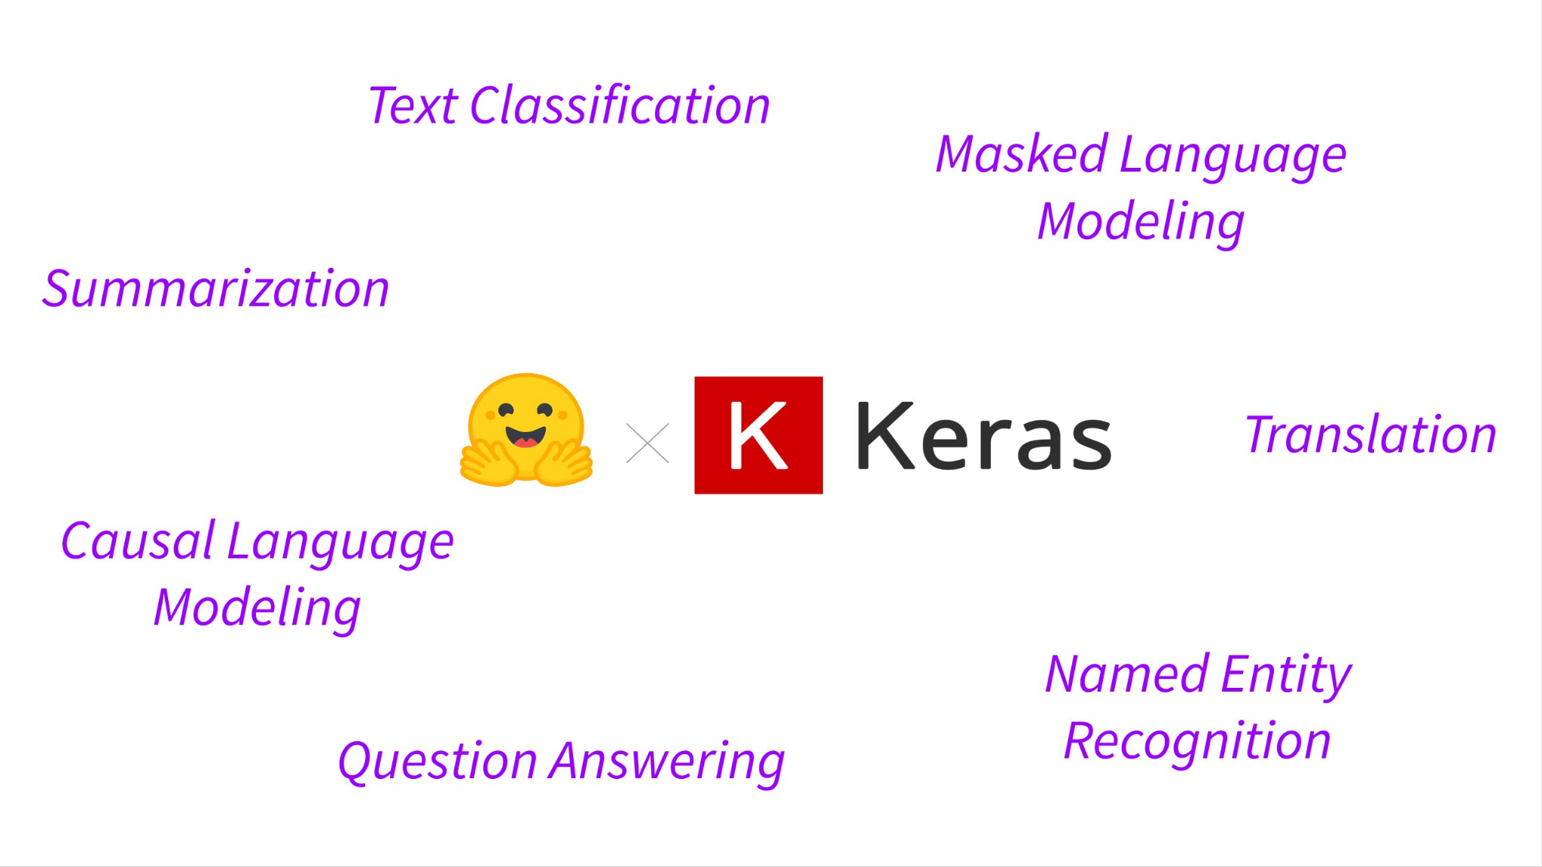
Use with any library you love!

Slide 14
Usual workflow
Model Hub
Model
Model Hub
Pick a pretrained model
Upload it once trained
Train using a dataset
Datasets

Slide 15
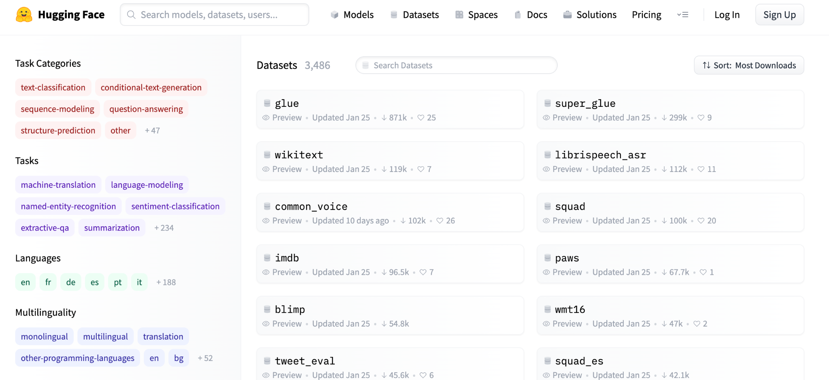
Datasets Hub
Notes:
The hub contains models, but it also contains datasets. The datasets hub is a catalogue of datasets shared by the community that you can load in 1 line of python. It contains well known datasets such as SQuAD or the GLUE benchmark, as well as many other datasets for classification, question answering, summarization, language modeling etc.
The datasets hub has more than 800 datasets. As for the model hub, each dataset comes with versioning using git for reproducibility.

Slide 16
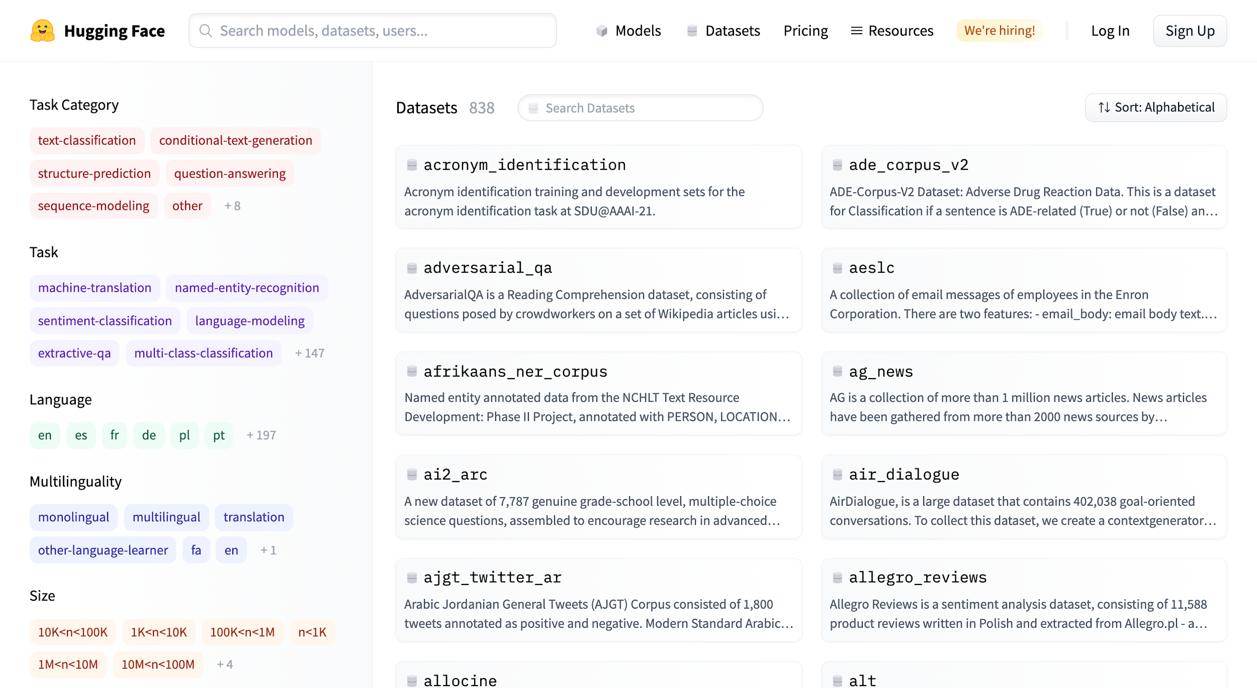
Datasets
🗞
The Hub:
Largest hub of ready-to-use datasets
3000+ Datasets available
450+ languages and dialects supported

Slide 17
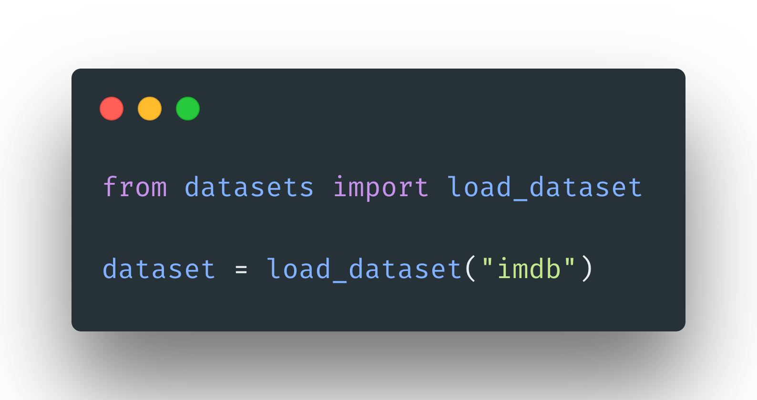
Datasets
🗞
The python library:
- Load any dataset in one line
- Supports huge datasets without RAM limitations
- Fast iterations and querying

